Slide 2
The long road to bayesian model comparisons
department < ... >
research group < ... >
Or: How to acquire and interpret the ‘exceedance probability’, from start to finish

Slide 3
Contents
Model specification
Model estimation
Maximum Likelihood
Bayesian
Model comparison
Fixed effects
Mixed effects

Slide 4

Model specification

Slide 5

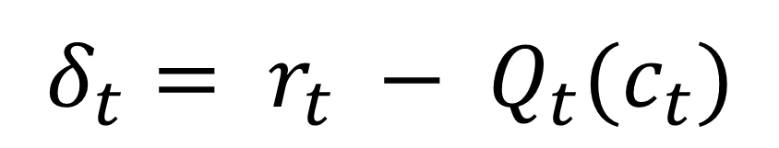
Examples from RL
Model-Free RL (Q-learning)
$$Q_{t+1}\left(c_{t}\right)=Q_{t}\left(c_{t}\right)+α∙δ_{t}$$
$$δ_{t}= r_{t} − Q_{t}(c_{t})$$
Daw (2009)

Slide 6
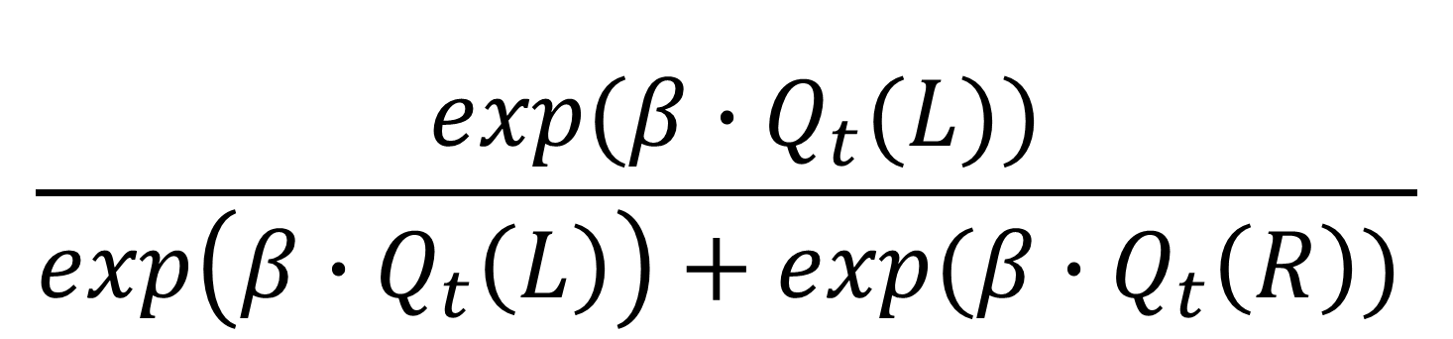

Choices
Softmax function
$$P\left(c_{t}=L|Q_{t}\left(L\right),Q_{t}(R)\right)$$
$$\frac{⁡exp(β∙Q_{t}(L))}{\exp\left(β∙Q_{t}\left(L\right)\right)+exp⁡(β∙Q_{t}\left(R\right))⁡}$$

Slide 7


Competing models
Dual learning rate
Frank et al. (2007)
$$Q_{t+1}\left(c_{t}\right)= Q_{t}\left(c_{t}\right)+ a_{G}[δ_{t}]_{+} +a_{L}[δ_{t}]_{−}$$
Fixed Bias
$$P\left(c_{t}=L\right)= α$$
$$P\left(c_{t}=R\right)=1−α$$

Slide 8
Parameters to estimate
Model Free Q-Learning
Model:
Learning Rate: α
Softmax / Logistic Regression:
Inverse Temperature: β
Dual Learning Rates
Model:
Learning Rate Gain: α_{G}
Learning Rate Loss: α_{L}
Softmax / Logistic Regression:
Inverse Temperature: β
Fixed Bias
Model:
Bias: α
x2
x3
x1

Slide 9
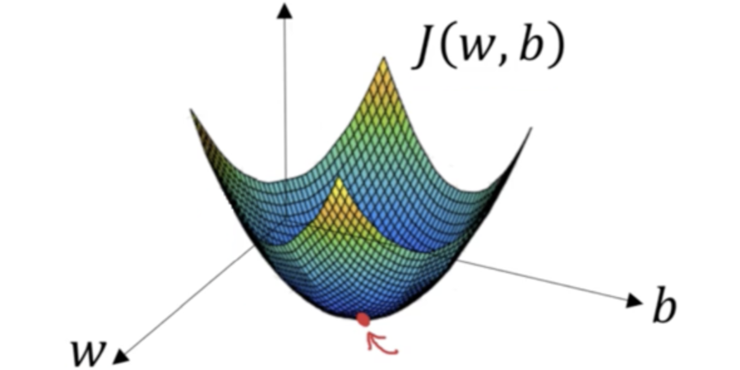
Model Estimation

Slide 10
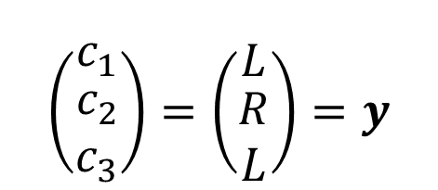
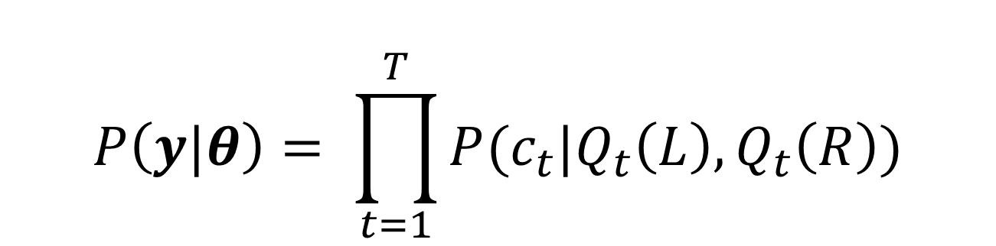
Maximum likelihood
$$\left(\begin{matrix}c_{1} \\ \begin{aligned}c_{2} \\ c_{3}\end{aligned}\end{matrix}\right)=\left(\begin{matrix}L \\ \begin{aligned}R \\ L\end{aligned}\end{matrix}\right)=y$$
$$P\left(y\right)=P\left(c_{1},c_{2},c_{3}\right)=P(c_{1})∙P(c_{2})∙P(c_{3})$$
$$P\left(y|θ\right)= \prod_{t=1}^{T}{P(c_{t}|Q_{t}\left(L\right),Q_{t}\left(R\right))}$$
‘Given theta’

Slide 11
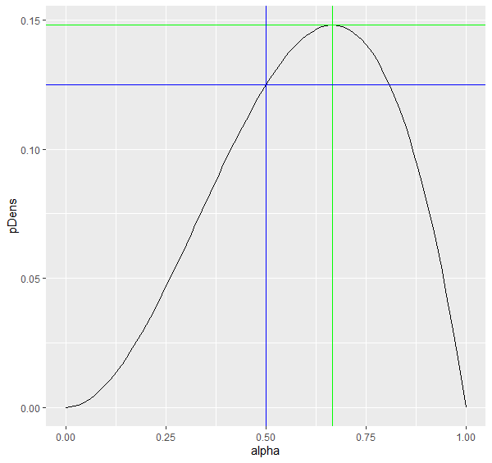
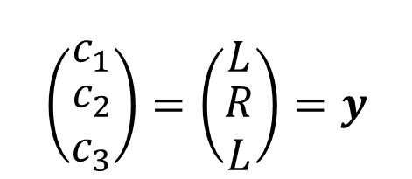
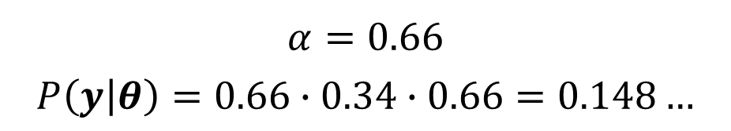

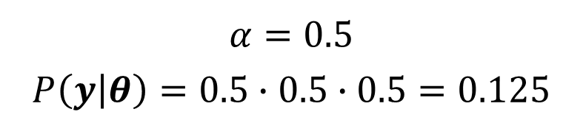

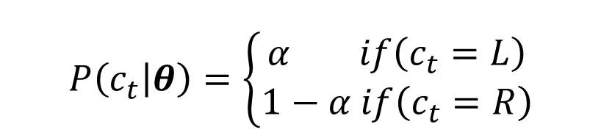
ML Example
Fixed Bias
$$θ=\{α\}$$
$$\left(\begin{matrix}c_{1} \\ \begin{aligned}c_{2} \\ c_{3}\end{aligned}\end{matrix}\right)=\left(\begin{matrix}L \\ \begin{aligned}R \\ L\end{aligned}\end{matrix}\right)=y$$
$$P\left(c_{t} | θ\right)=\left\{\begin{aligned}α if\left(c_{t}=L\right) \\ 1−α if\left(c_{t}=R\right)\end{aligned}\right.$$
$$P\left(y | θ\right)= α∙(1−α)∙α$$
$$α=0.5$$
$$P\left(y | θ\right)=0.5∙0.5∙0.5=0.125$$
$$α=0.66$$
$$P\left(y | θ\right)=0.66∙0.34∙0.66=0.148…$$

Slide 12
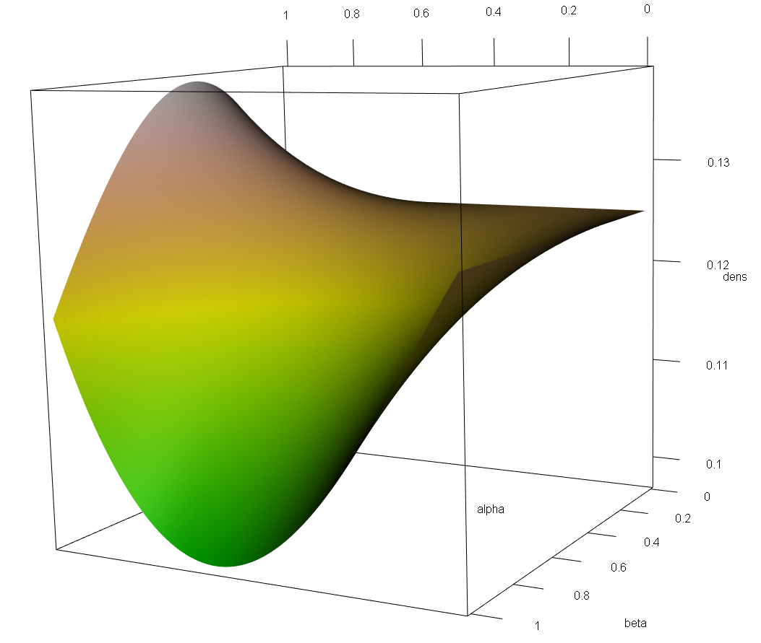

ML Example
Model Free Q-Learning
$$θ=\{α,β\}$$

Slide 13
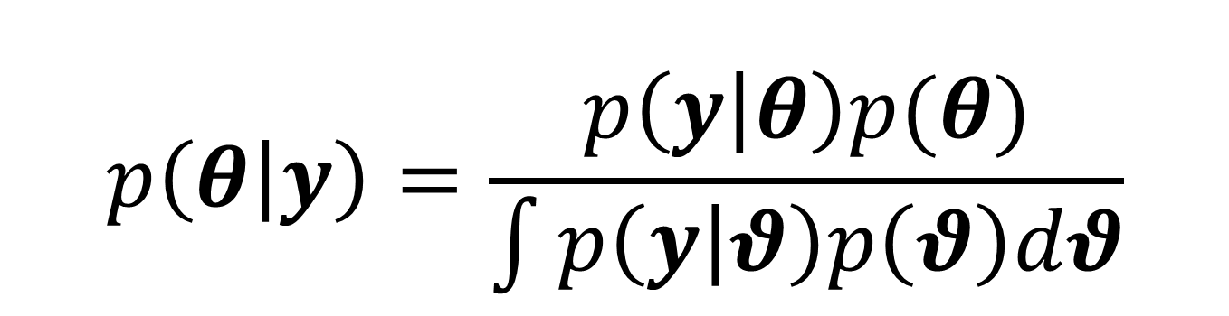
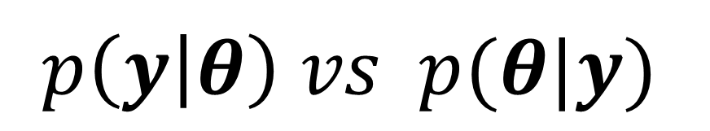
Bayesian
$$p\left(y | θ\right) vs p(θ|y)$$
Posterior distribution vs point estimate
$$p\left(θ | y\right)=\frac{p\left(y | θ\right)p(θ)}{\int{p\left(y | θ\right)p\left(θ\right)dθ}}$$

Slide 14
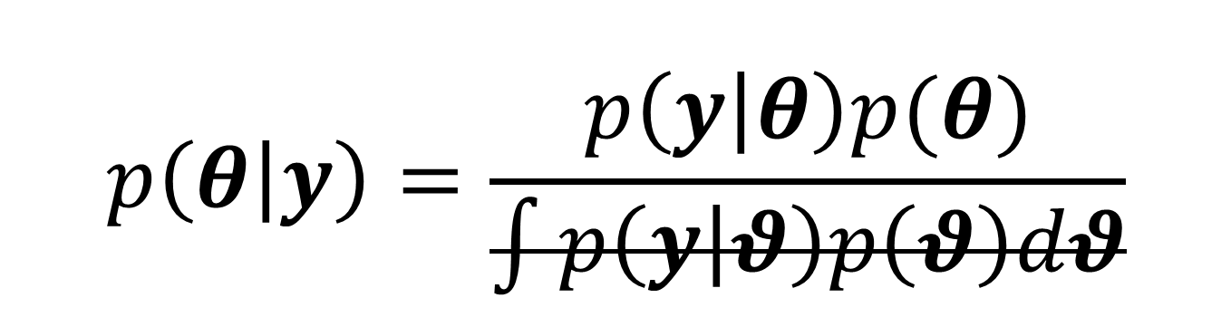
Bayesian
$$p\left(y | θ\right) vs p(θ|y)$$
Posterior distribution vs point estimate
$$p\left(θ | y\right)=\frac{p\left(y | θ\right)p(θ)}{\int{p\left(y | θ\right)p\left(θ\right)dθ}}$$

Slide 15

Bayesian
$$p\left(y | θ\right) vs p(θ|y)$$
Posterior distribution vs point estimate
$$p\left(θ | y\right) \text{∝} p\left(y | θ\right)p(θ)$$
Data likelihood
Prior distribution

Slide 16
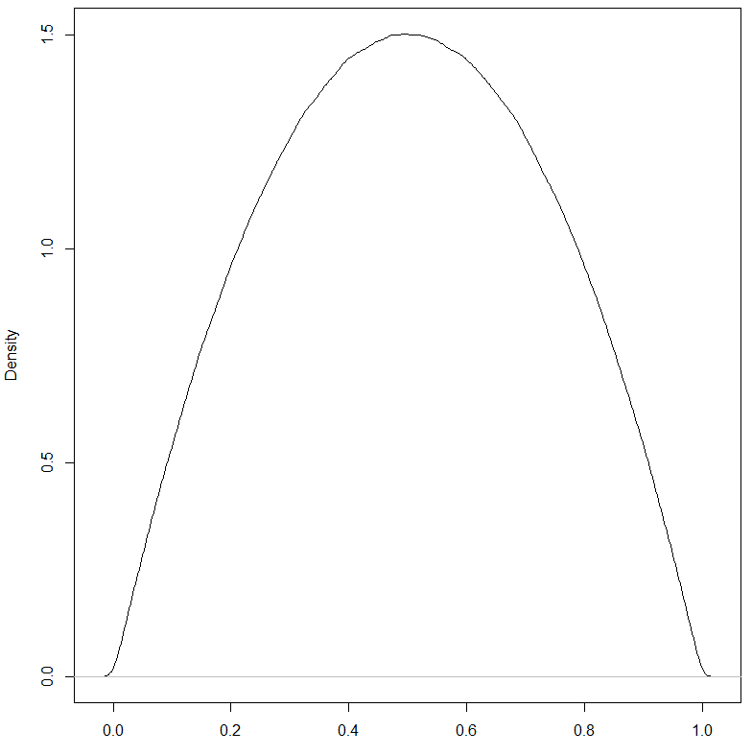

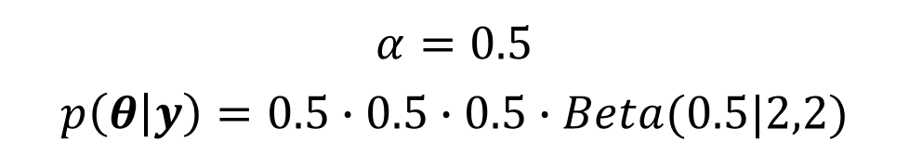


bayesian
Fixed bias
$$\left(\begin{matrix}c_{1} \\ \begin{aligned}c_{2} \\ c_{3}\end{aligned}\end{matrix}\right)=\left(\begin{matrix}L \\ \begin{aligned}R \\ L\end{aligned}\end{matrix}\right)=y$$
$$P\left(y | θ\right)= α∙(1−α)∙α$$
$$P\left(α\right) \sim Beta(2,2)$$
$$P\left(θ | y\right) \text{∝} α∙\left(1−α\right)∙α∙Beta(α|2,2)$$
$$α=0.5$$
$$p\left(θ | y\right)=0.5∙0.5∙0.5∙Beta(0.5|2,2)$$

Slide 17
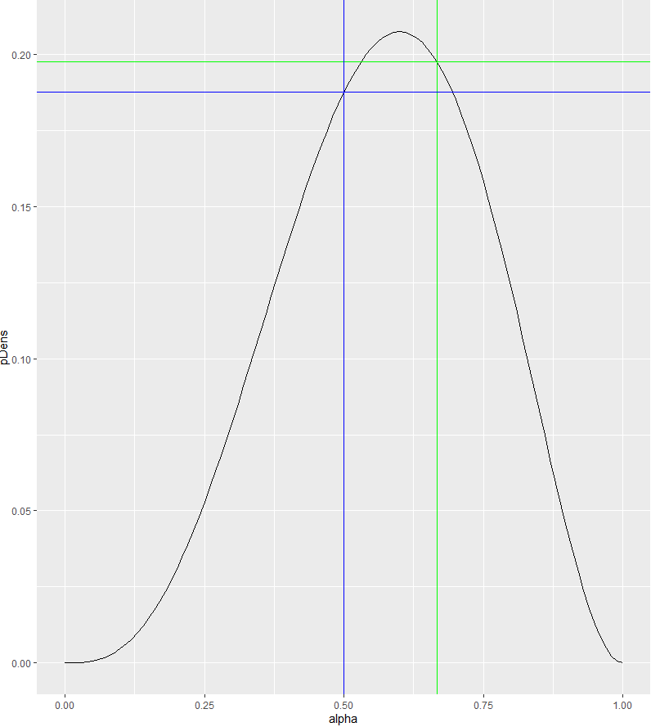
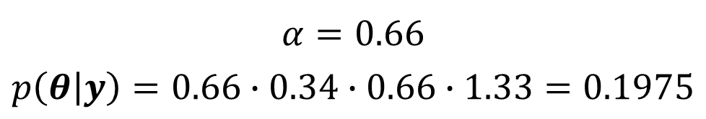
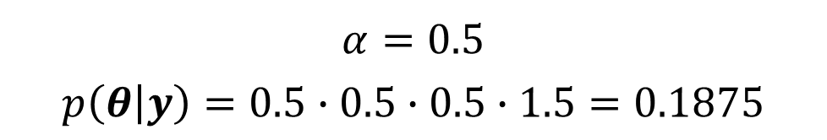
bayesian
Fixed bias
$$\left(\begin{matrix}c_{1} \\ \begin{aligned}c_{2} \\ c_{3}\end{aligned}\end{matrix}\right)=\left(\begin{matrix}L \\ \begin{aligned}R \\ L\end{aligned}\end{matrix}\right)=y$$
$$P\left(y | θ\right)= α∙(1−α)∙α$$
$$P\left(α\right) \sim Beta(2,2)$$
$$P\left(θ | y\right) \text{∝} α∙\left(1−α\right)∙α∙Beta(α|2,2)$$
$$α=0.5$$
$$p\left(θ | y\right)=0.5∙0.5∙0.5∙1.5=0.1875$$
$$α=0.66$$
$$p\left(θ | y\right)=0.66∙0.34∙0.66∙1.33=0.1975$$

Slide 18
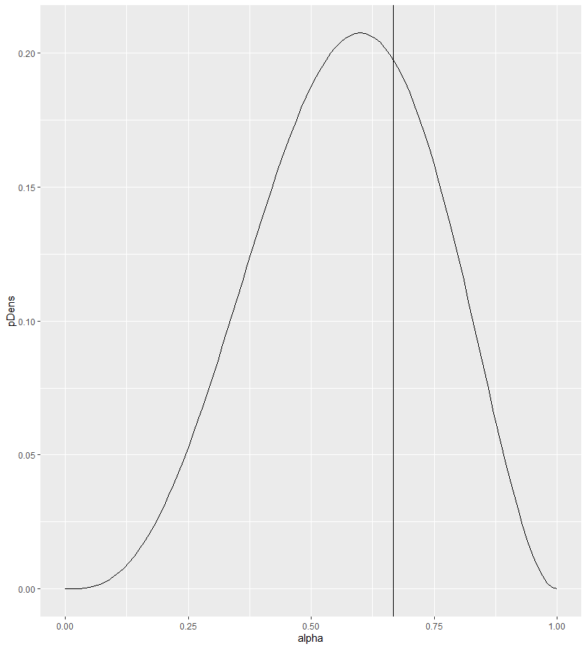
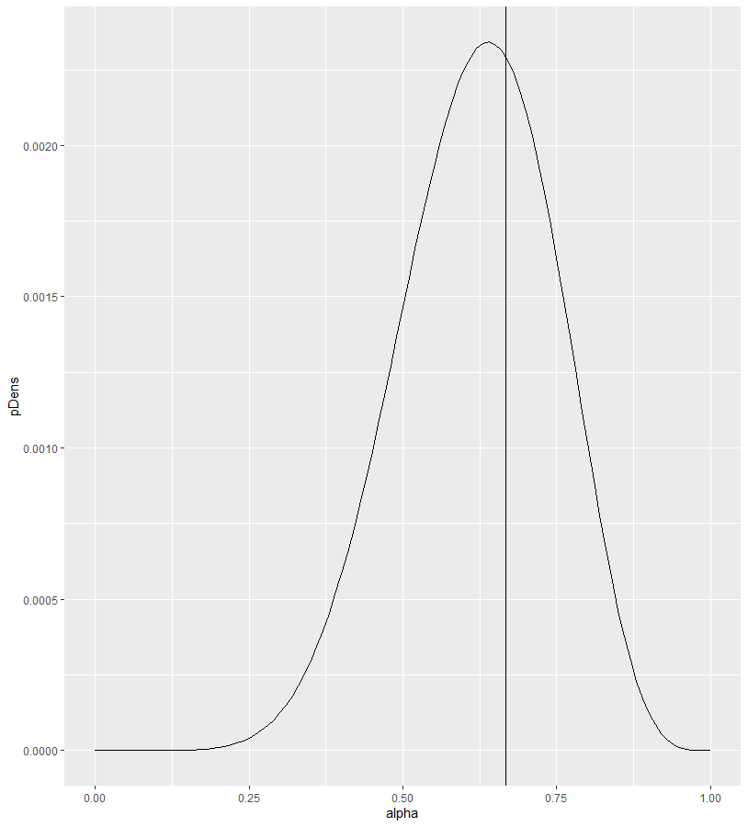
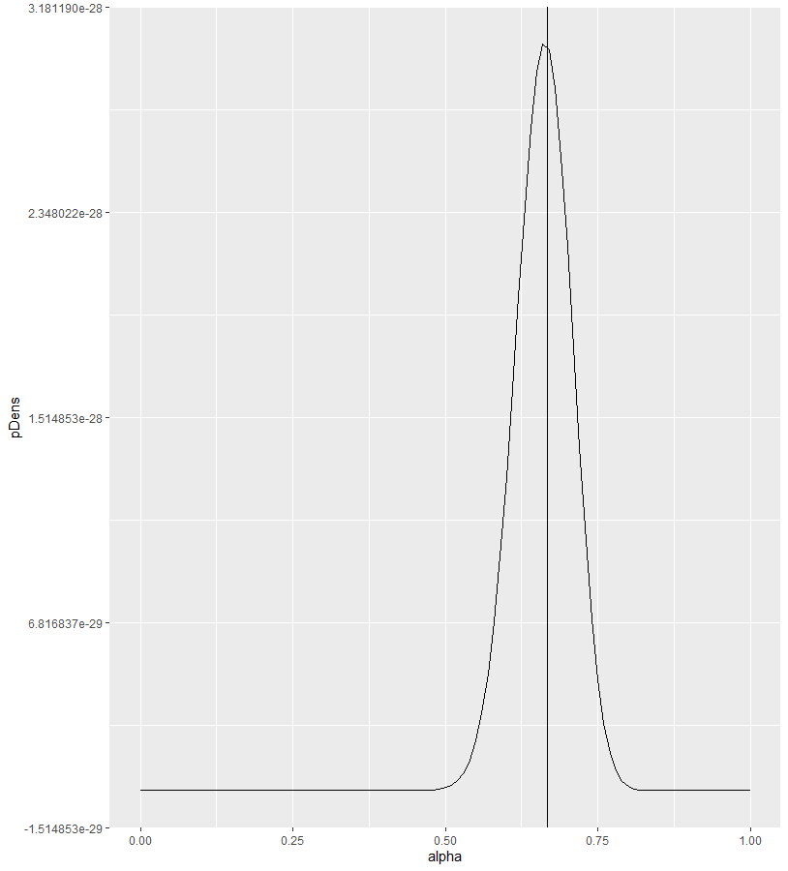

bayesian
Data Matters!
True: $α=0.66, p\left(α\right)\sim Beta(2,2)$
N = 3
N = 10
N = 100

Slide 19
Bayesian
How to benefit from having multiple participants?
Concatenate data?
What about individual differences?
Hierarchical modeling!

Slide 20


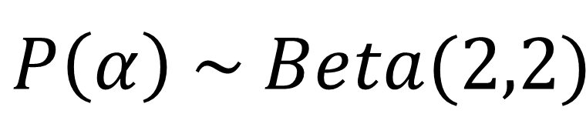
Hierarchical bayesian
Population distribution
$$p\left(θ | y\right) \text{∝} p\left(y | θ\right)p(θ)$$
$$p\text{(}y\text{|}θ\text{) }\sim Bern(y|α)$$
$$P\left(α\right) \sim Beta(2,2)$$
Fixed population distribution

Slide 21
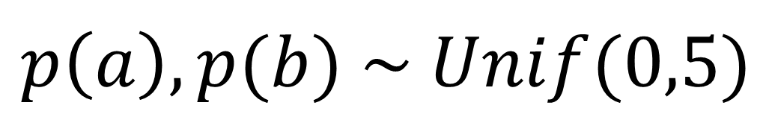
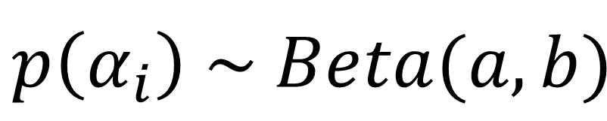


Hierarchical Bayesian
M participants
$$p\left(θ_{i} | y_{i}\right) \text{∝} p\left(y_{i} | θ_{i}\right)p(θ_{i})$$
$$p\text{(}y_{i}\text{|}θ_{i}\text{) }\sim Bern(y_{i}|α_{i})$$
$$p\left(α_{i}\right) \sim Beta(a,b)$$
$$p\left(a\right),p(b) \sim Unif(0,5)$$

Slide 22
Hierarchical Bayesian
M participants
$$p\left(θ_{i} | y_{i}\right) \text{∝} p\left(y_{i} | α_{i}\right)p\left(α_{i}|a,b\right)p\left(a\right)p(b)$$
$$p\text{(}y_{i}\text{|}θ_{i}\text{) }\sim Bern(y_{i}|α_{i})$$
$$p\left(α_{i}\right) \sim Beta(a,b)$$
$$p\left(a\right),p(b) \sim Unif(0,5)$$

Slide 23
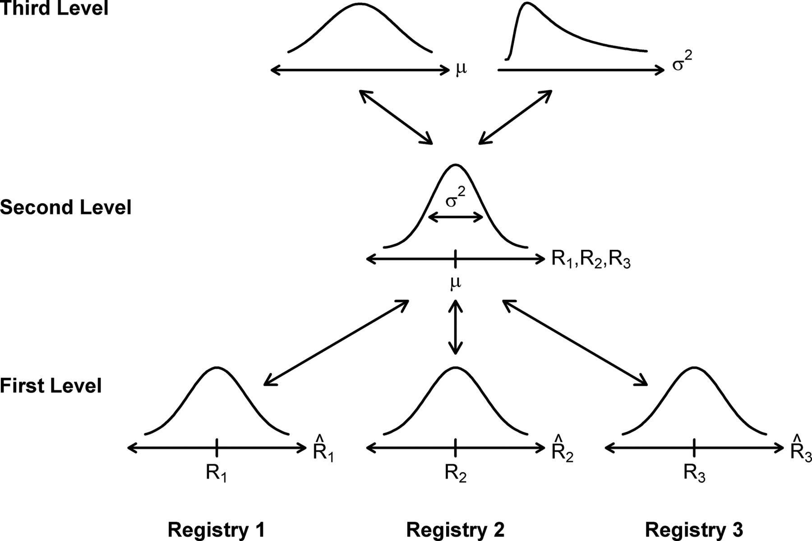
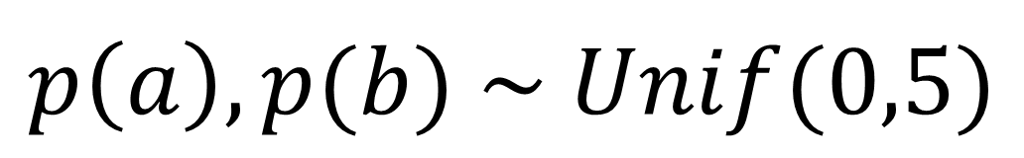

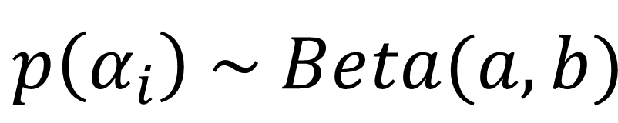
Hierarchical bayesian
$$p\left(a\right),p(b) \sim Unif(0,5)$$
$$p\left(α_{i}\right) \sim Beta(a,b)$$
$$p\text{(}y_{i}\text{|}θ_{i}\text{) }\sim Bern(y_{i}|α_{i})$$
(L, R, L)
(L, R, R)

Slide 24

Model Comparison

Slide 25
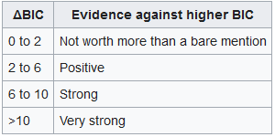



Model evidence
Maximum Likelihood
$$p(y|ℳ)$$
$$p\text{(}y\text{|}θ\text{)?}$$
$$BIC=k ∙\ln\left(n\right)−2 ∙ln⁡(\hat{L})$$
Nr. of parameters
Sample size
RM ANOVA – appropriate!
Stephan et al. (2009)

Slide 26
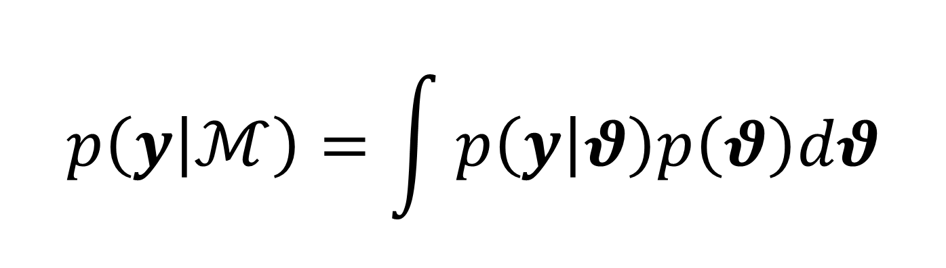
Model evidence
Bayesian
$$p\left(y | ℳ\right)=\int{p\left(y | θ\right)p\left(θ\right)dθ}$$

Slide 27
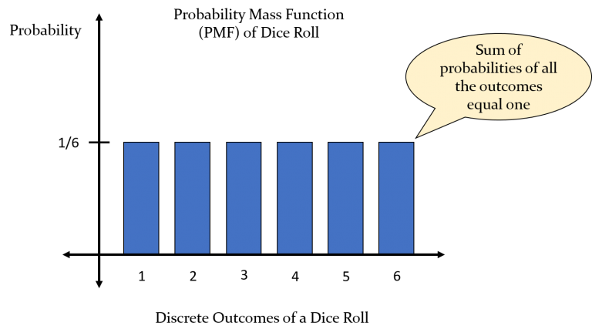
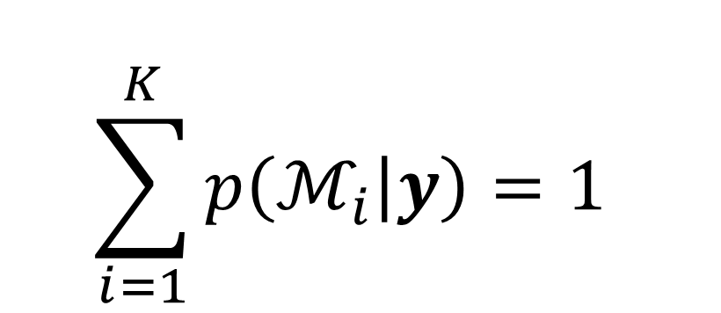
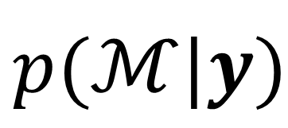
Bayesian model comparison
$$p(ℳ|y)$$
$$\sum_{i=1}^{K}{p\left(ℳ_{i} | y\right)=\text{1} }$$
Multinomial Distribution
6 parameters r

Slide 28
Bayesian model comparison
$$p(ℳ|y)$$
$$\sum_{i=1}^{K}{p\left(ℳ_{i} | y\right)=\text{1} }$$
Multinomial Distribution

Slide 29
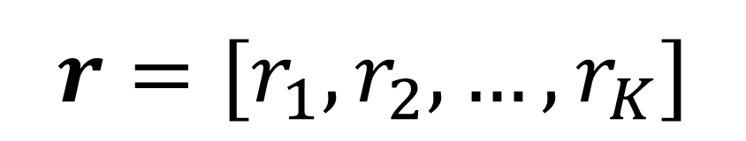
Multinomial distribution in bayes
$$r=[r_{1},r_{2},…,r_{K}]$$
r₂
r₁

Slide 30
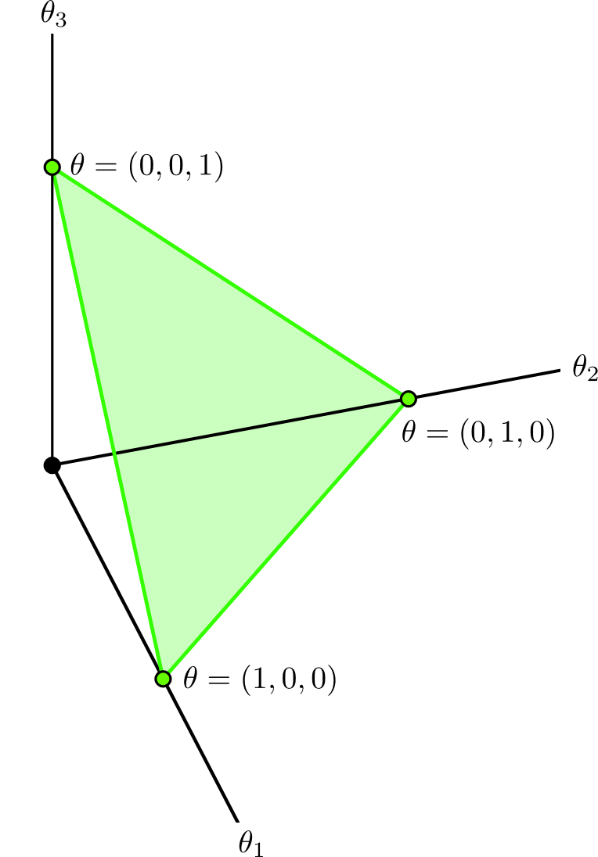
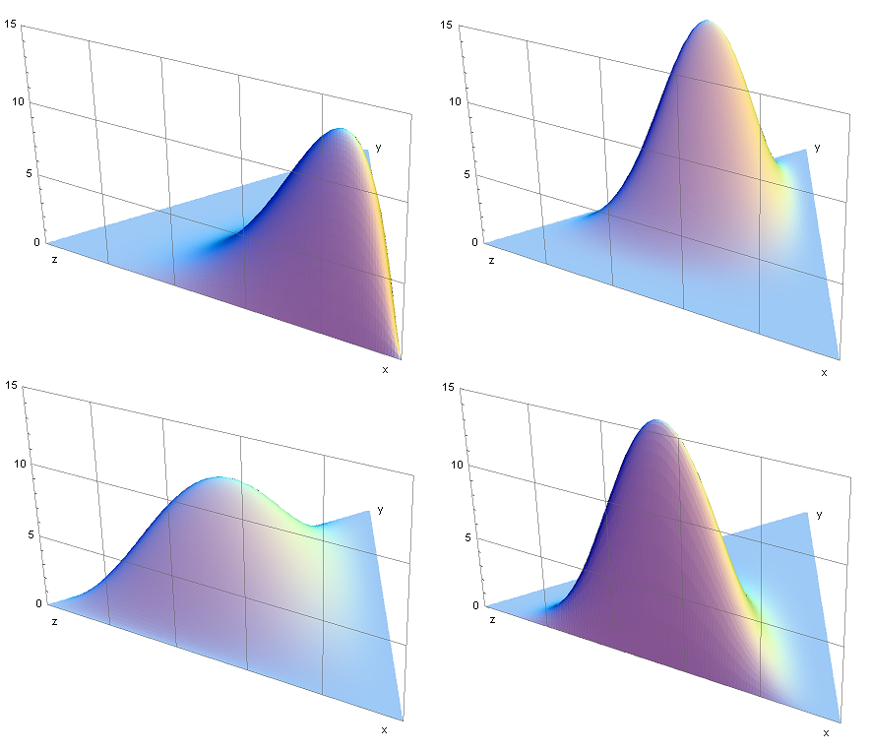
Dirichlet distribution
$$r=[r_{1},r_{2},…,r_{K}]$$
“Simplex”
Dirichlet Distribution

Slide 31
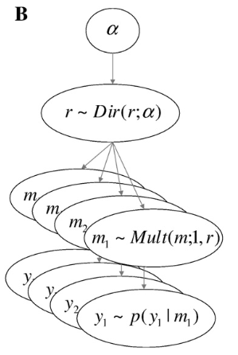
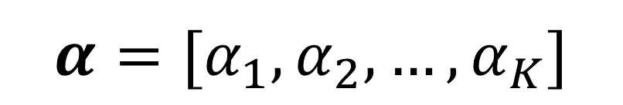
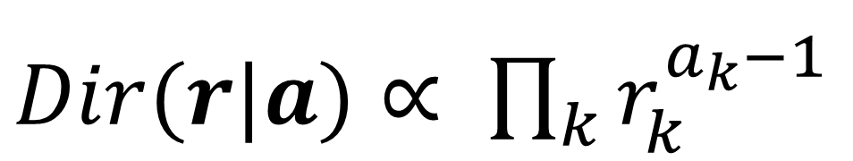

Inferring model probabilities
$$r=[r_{1},r_{2},…,r_{K}]$$
Model Probabilities
$$α=[α_{1},α_{2},…,α_{K}]$$
Model Counts
$Dir(r|a)$ $∝ \prod_{k}{r_{k}^{a_{k}−1}}$
Different r for each participant is unified under a Dirichlet population distribution for Model Probabilities
Different multinomial r for data of each participant!
Model Evidences for all participants

Slide 32
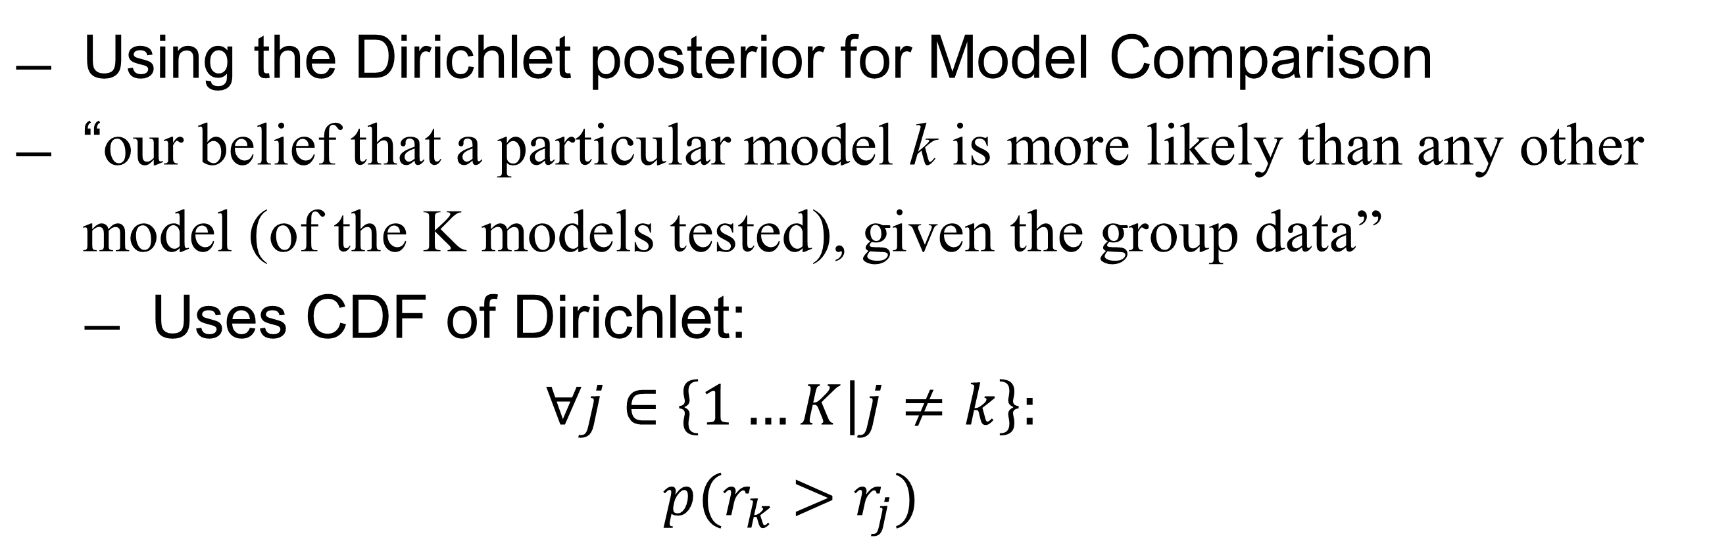
Exceedance probability
Using the Dirichlet posterior for Model Comparison
“our belief that a particular model k is more likely than any other model (of the K models tested), given the group data”
Uses CDF of Dirichlet:
$$∀j∈\left\{1…K | j≠k\right\}:$$
$$p(r_{k}>r_{j})$$

Slide 33
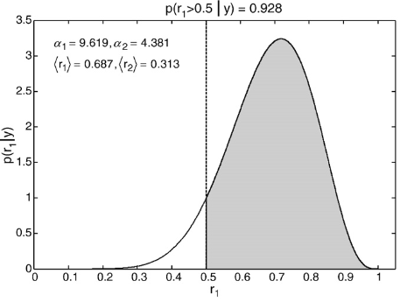

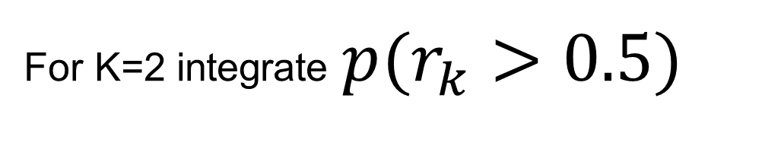
Exceedance probability
$$∀j∈\left\{1…K | j≠k\right\}:$$
$$p(r_{k}>r_{j})$$
For K=2 integrate $p(r_{k}>0.5)$

Slide 34
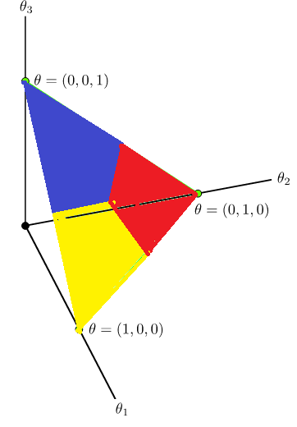

Exceedance probability
$$∀j∈\left\{1…K | j≠k\right\}:$$
$$p(r_{k}>r_{j})$$
For K=3 integrate $???$

Slide 35
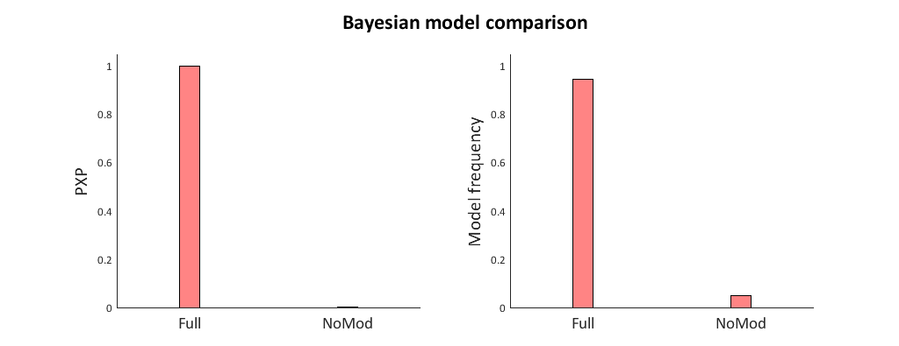

Exceedance vs occurrence
$$φ_{k}=p(r_{k}>r_{j})$$

Slide 36
A reiteration of steps
Define an equation for the likelihood of your data given one or more parameters
Figure out a good set of parameters
ML: Point Estimate
Bayes: Posterior Distribution
Get all model evidences
ML: BIC (AIC, wAIC)
Bayes: Marginal Likelihood (DIC)
Estimate the parameters of the Population Dirichlet using the model evidences for every model for every participant
Find and integrate a region to get an exceedance probability
Inspect the model frequencies
Separately per participant!
Separately per participant!

Slide 37
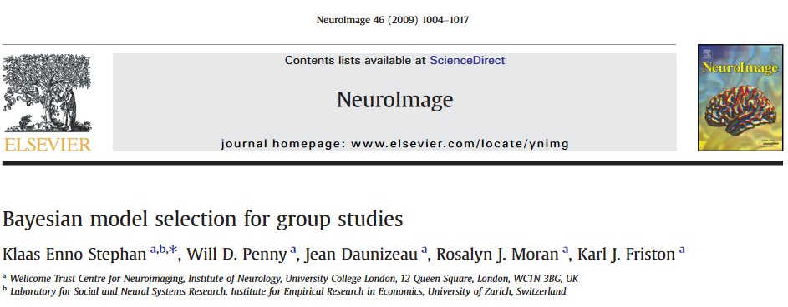


What did we miss
Protected Exceedance Probability (PXP)
Bayesian Omnibus Risk (BOR)
Combine Hierarchical Bayesian parameter estimation with Bayesian Model Comparison

Slide 38



< presenter’s name > < job title > < DEPARTMENT OR RESEARCH GROUP > E <first name>.<surname>@ugent.be T +32 9 000 00 00 M +32 400 00 00 00 www.ugent.be
Universiteit Gent @ugent
@ugent Ghent University

